Slide 1





Scale your dev AI: From dev AzureML to prod OpenShift in one click
Salah Chadli
Guillaume Chervet
Sr. Data Scientist - AI Engineer
TechLead – ML Engineer

Slide 2
1
Problematics of complex Deep Learning projects
2
Workflow & Architecture Overview
3
AI dev and training on AzureML
4
Deployment on OpenShift
5
Conclusion

Slide 3
1
Problematics of complex Deep Learning projects

Slide 4
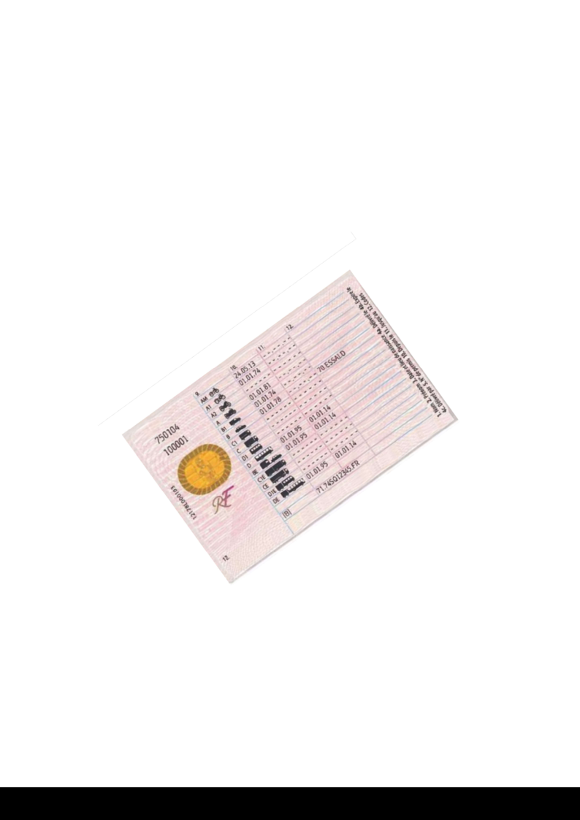
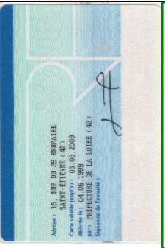



Page
Zoning
Straightening
Zoning
OCR
Split
Split
Zoning
Straightening
Zoning
OCR

Slide 5
2
Workflow & Architecture Overview

Slide 6
Exploration phase

Slide 7




Exploration phase
AzureML dev
Annotations
+
Data
Automated Training Pipeline
Data Validation
Data Preparation
Model Training
Model Evaluation
Model Registry
Model Register

Slide 8

Exploration phase
AzureML dev
Annotations
+
Data
Automated Training Pipeline
Data Validation
Data Preparation
Model Training
Model Evaluation
Model Registry
Model Register

Slide 9
Exploration phase
AzureML dev
Annotations
+
Data
Automated Training Pipeline
Data Validation
Data Preparation
Model Training
Model Evaluation
Model Registry
Model Register
AI metrics
Estimate production cost
Estimate response time
Train code

Slide 10
Production phase

Slide 11
Production phase
AzureML dev
Automated Training Pipeline
Data Validation
Data Preparation
Model Training
Model Evaluation
Model Registry
Model Register

Slide 12

Production phase
AzureML dev
Automated Training Pipeline
Data Validation
Data Preparation
Model Training
Model Evaluation
Model Registry
Model Register
Docker registry

Slide 13


Production phase
AzureML dev
Automated Training Pipeline
Data Validation
OpenShift dev
Data Preparation
Model Training
zoning
ocr
homography
Model Evaluation
Model Registry
Model Register
OpenShift rec
zoning
ocr
homography
Docker registry

Slide 14
Production phase
AzureML dev
Automated Training Pipeline
Data Validation
OpenShift dev
Data Preparation
Model Training
zoning
ocr
homography
Model Evaluation
Model Registry
Model Register
OpenShift rec
zoning
ocr
homography
Docker registry

Slide 15
Production phase
AzureML dev
Automated Training Pipeline
Data Validation
OpenShift dev
Data Preparation
Model Training
zoning
ocr
homography
Model Evaluation
Model Registry
Model Register
OpenShift rec
zoning
ocr
homography
OpenShift pre-prod
Docker registry
AzureML prod
zoning
ocr
homography
Automated Training Pipeline
OpenShift prod
Data Validation
Data Preparation
Model Training
zoning
ocr
homography
Model Evaluation
Model Registry
Model Register

Slide 16
Production phase
AzureML dev
Automated Training Pipeline
Data Validation
OpenShift dev
Data Preparation
Model Training
zoning
ocr
homography
Model Evaluation
Model Registry
Model Register
OpenShift rec
zoning
ocr
homography
OpenShift pre-prod
Docker registry
AzureML prod
zoning
ocr
homography
Automated Training Pipeline
OpenShift prod
Data Validation
Data Preparation
Model Training
zoning
ocr
homography
Model Evaluation
Model Registry
Model Register

Slide 17
Production phase
AzureML dev
Automated Training Pipeline
Data Validation
OpenShift dev
Data Preparation
Model Training
zoning
ocr
homography
Model Evaluation
Model Registry
Model Register
OpenShift rec
zoning
ocr
homography
OpenShift pre-prod
Docker registry
AzureML prod
zoning
ocr
homography
Automated Training Pipeline
OpenShift prod
Data Validation
Data Preparation
Model Training
zoning
ocr
homography
Model Evaluation
Model Registry
Model Register

Slide 18
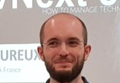
Production phase
AzureML dev
Automated Training Pipeline
Data Validation
OpenShift dev
Data Preparation
Model Training
zoning
ocr
homography
Model Evaluation
Model Registry
Model Register
OpenShift rec
zoning
ocr
homography
OpenShift pre-prod
Docker registry
AzureML prod
zoning
ocr
homography
Automated Training Pipeline
OpenShift prod
Data Validation
Data Preparation
Model Training
zoning
ocr
homography
Model Evaluation
Model Registry
Model Register

Slide 19
Production phase
AzureML dev
Automated Training Pipeline
Data Validation
OpenShift dev
Data Preparation
Model Training
zoning
ocr
homography
Model Evaluation
Model Registry
Model Register
OpenShift rec
zoning
ocr
homography
OpenShift pre-prod
Docker registry
AzureML prod
zoning
ocr
homography
Automated Training Pipeline
OpenShift prod
Data Validation
Data Preparation
Model Training
zoning
ocr
homography
Model Evaluation
Model Registry
Model Register

Slide 20
3
AI dev and training on AzureML

Slide 21
Azure ML

Slide 22
Page
Zoning
Straightening
Zoning
OCR
Split
Split
Zoning
Straightening
Zoning
OCR
Notes:
Guillaume
10 mins

Slide 23
Project folder organisation

Slide 24
Trigger train from CI

Slide 25
Train from CI => model tags

Slide 26
PullRequest Policies

Slide 27
4
Deployment on OpenShift

Slide 28
Production code

Slide 29
Build production docker

Slide 30
Update infrastructure code

Slide 31
Function orientation_recto demo

Slide 32
Deploy from dev to staging

Slide 33
5
Conclusion

Slide 34
Merci !

Slide 36


Production phase
OpenShift prod
zoning
ocr
homography
Data Drift Metrics
Infrastructure Metrics
Production Alerting

Slide 37
Debug Monitoring Alerting

Slide 40
Production phase
AzureML dev
Automated Training Pipeline
Data Validation
OpenShift dev
Data Preparation
Model Training
zoning
ocr
homography
Model Evaluation
Model Registry
Model Register
OpenShift rec
zoning
ocr
homography
OpenShift pre-prod
Docker registry
AzureML dev
zoning
ocr
homography
Automated Training Pipeline
OpenShift prod
Data Validation
Data Preparation
Model Training
zoning
ocr
homography
Model Evaluation
Model Registry
Model Register

